Slide 1
MAE 431 CPU Heat Transfer Project
Presented by:
Matthew Berry
Patricia Brown
Oscar Velasquez
Eloy Acevedo

Slide 2
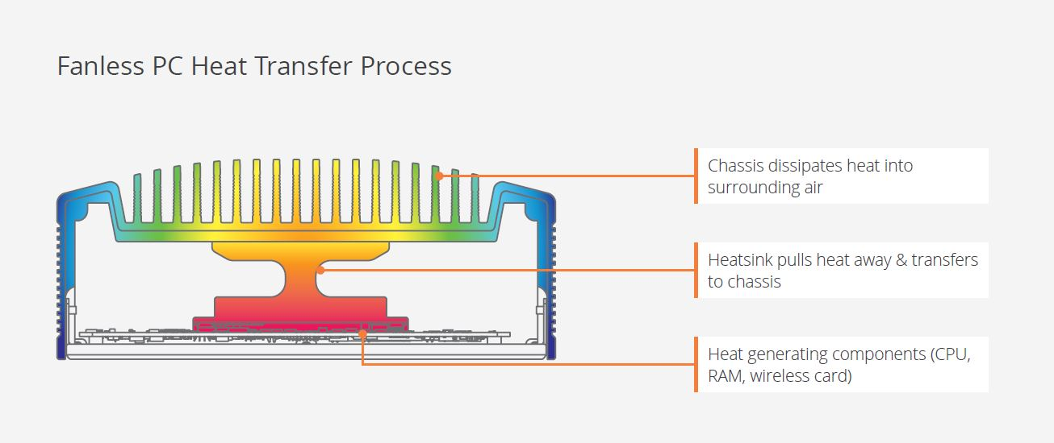
Objective
The objective of this project is to measure the temperature distribution through an air cooled CPU.

Slide 3
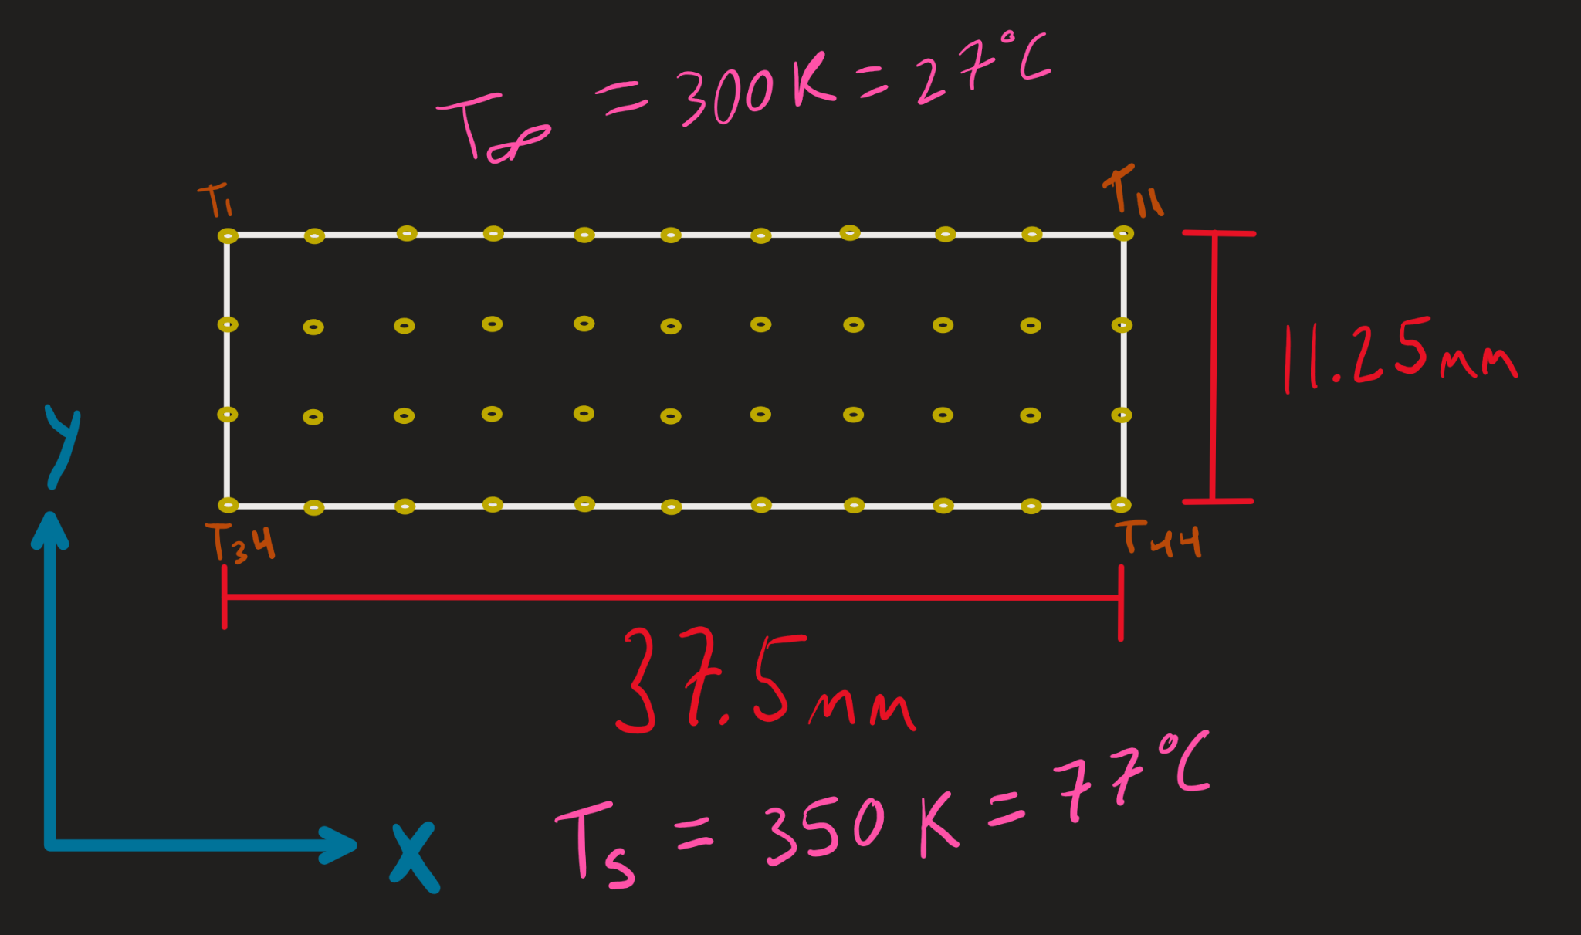
Problem Setup
Define material to obtain conductive properties (silicone).
Define convective heat transfer coefficient (user input)
Determine CPU size and nodal spacing.
Define base temperature.
Calculate temperature distribution through the CPU.

Slide 4
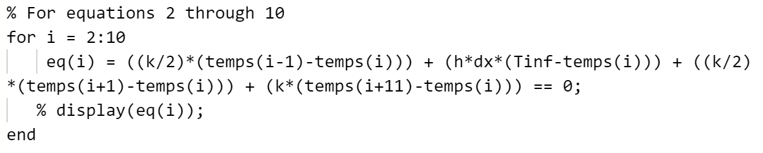
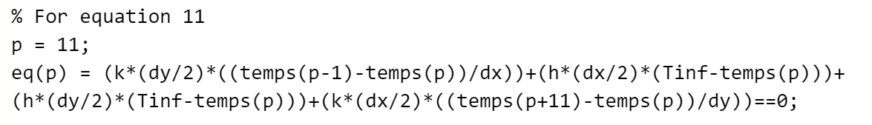
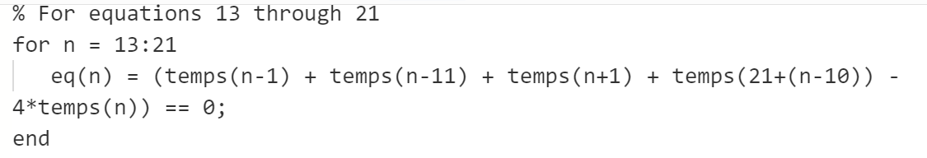
Solution and Procedure
Accept convective heat transfer coefficient from user
Define x and y dimensions of CPU, node quantity, nodal spacing, conductive heat transfer coefficient, and ambient temperature
Create an array of symbolic temperatures
Define bottom row of nodes all equal to 350K
Define nodal equations
Nodes 1,12, 2-10, 13-21, and 24-32 are defined using for loops
All other nodes are explicitly defined
Solve function solves nodal system of equations
Structure is converted to array and results are displayed.

Slide 5
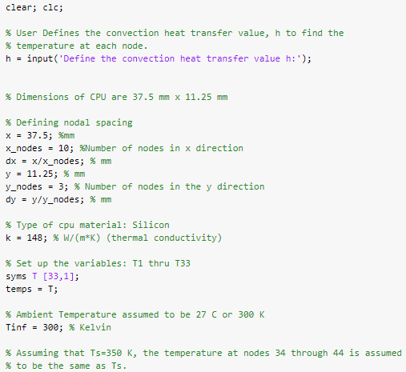
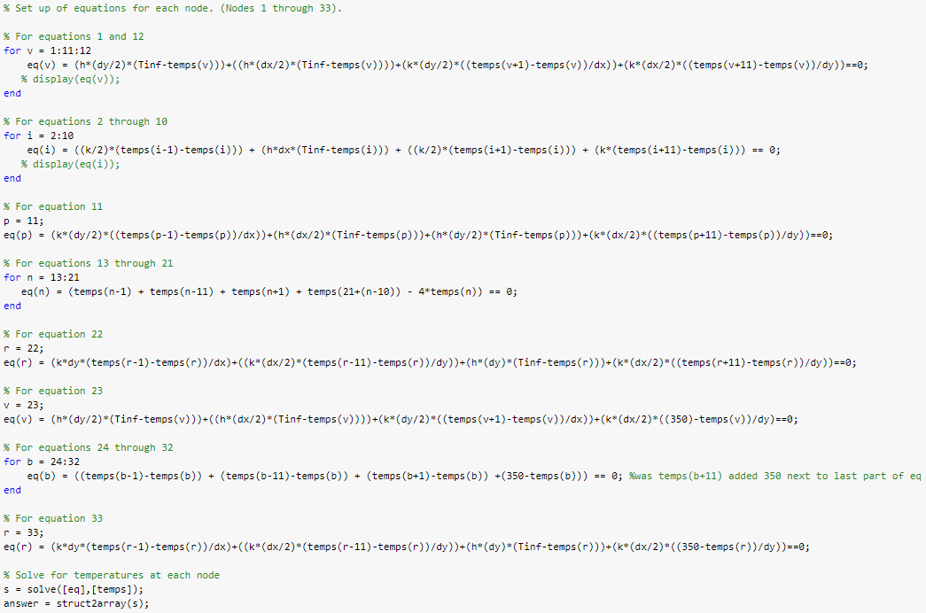
Code Documentation

Slide 6
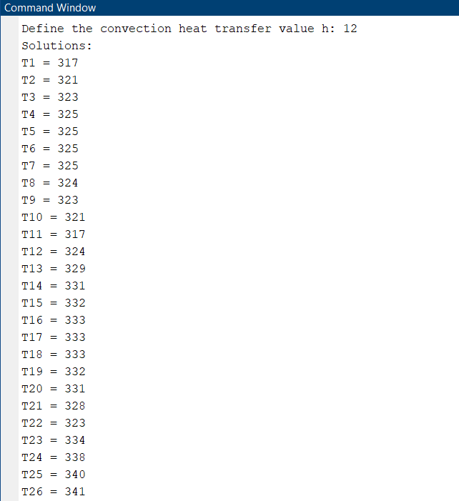
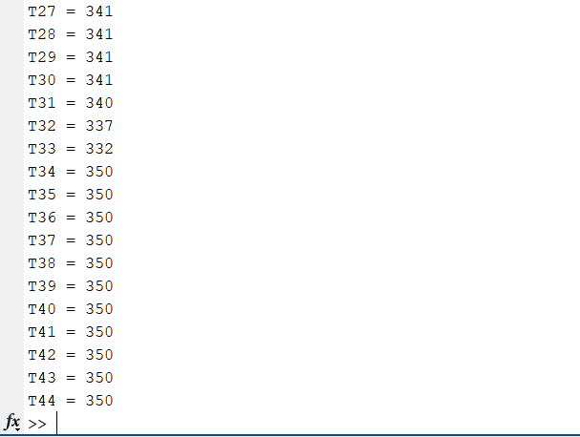
Discussion of Results
For the convection heat transfer coefficient we selected the value of 12W/(m² * K) and we are assuming forced flow in this instance instead of free flow.

Slide 7
Conclusions and Recommendations
As expected, temperatures are distributed approximately symmetrically.
Nodes near the CPU boundaries have the lowest temperature while nodes near the center have higher temperatures.
Future additions to the code that can be made:
Make the dimensions of the CPU user defined
Make the material user defined & allow for a composition of materials (or have a variety of material compositions that the user can choose from)
Allow for different methods of cooling that the user can choose from
Analyze the temperature distribution in three dimensions
Integrate code with other groups to determine base temperatures.

